Slide 1
The ImPrEP Project overview and selected results
Valdiléa G. Veloso, MD, Ph.D
Evandro Chagas National Institute
of Infectious Diseases
Fiocruz, Brazil

Slide 2
Disclosure
I have no conflicts to disclose

Slide 3
New HIV infections and AIDS deaths in Latin America and the Caribbean, 2004-2018
Source: UNAIDS. Spectrum HIV estimates 2019 and UNAIDS/WHO. Global AIDS monitoring country responses, 2019

Slide 4
Distribution of new HIV infections (aged 15–49 years), by population group, Latin America and the Caribbean, 2019
Sex workers
3%
People who inject drugs
2%
People who inject drugs
3%
Sex workers 6%
Remaining population 23%
Gay men and other men who have sex with men
26%
Gay men and other men who have sex with men
44%
Latin America
Remaining population 40%
The Caribbean
5%
Transgender women
22%
Clients of sex workers and sex partners of key populations
20%
Clients of sex workers and sex partners of key populations
6%
Transgender women
Source: GAM country reported data and UNAIDS/WHO estimates, 2020.

Slide 5
Prevalence of HIV infection in MSM, latest reported data
35
30
25
Percentage (%)
20
15
10
5
0
St Vincent and the Gren…
Saint Kitts and Nevis
Antigua and Barbuda
Barbados
Dominica
Dominican Republic
Haiti
Grenada
Guyana
Cuba
El Salvador
Uruguay
Nicaragua
Guatemala
Panama
Saint Lucia
Peru
Honduras
Argentina
Mexico
Bahamas
Belize
Chile
United States of America
Canada
Costa Rica
Ecuador
Suriname
Colombia
Brazil
Bolivia
Paraguay
Venezuela
Jamaica
Trinidad and Tobago
2018 2013 2013 2017 2018 2018 2019 2018 2014 2018 2019 2018 2016 2018 2019 2019 2019 2019 2014 2019 2018 2012 2016 2014 2013 2018 2017 2018 2016 2017 2018 2017 2019 2018 2015
Source: PAHO, 2020. Obtained from Spectrum HIV estimates 2019 and UNAIDS/WHO. Global AIDS monitoring country responses, 2020.

Slide 6
Prevalence of HIV infection in transgender women, latest reported data
Percentage (%)
60
50
40
30
20
10
0
Guyana
Mexico
Bolivia
Dominican Republic
Panama
Brazil
Peru
Cuba
Ecuador
Jamaica
Honduras
Nicaragua
Guatemala
Venezuela
Suriname
Costa Rica
2019
2016
2015
Colombia
2018
2016
2016
2018
2018
2018
2019
2017
2019
2019
2017
2019
2018
2018
Source: PAHO, 2020. Obtained from Spectrum HIV estimates 2019 and UNAIDS/WHO. Global AIDS monitoring country responses, 2020.

Slide 7
ImPrEP Leadership
Lead PI: Dr. Valdiléa Veloso, Fiocruz
Brazil PI: Dr Beatriz Grinsztejn, Fiocruz
Peru PI: Dr. Carlos Cáceres, Universidad Peruana Caetano Heredia
Mexico PI: Dr. Hamid Vega, Clínica Condesa and Dr. Sergio Bautista- Instituto Nacional de Salud Public

Slide 8
ImPrEP Project Design
Goal: to contribute to the reduction in HIV incidence among MSM and TGW in Brazil, Mexico and Peru through the inclusion of Pre- Exposure Prophylaxis (PrEP) as a component of HIV combination prevention.
Outcome: to contribute to increase PrEP uptake among high risk MSM and TGW in collaborating countries, contributing to increase PrEP adoption globally.
Funding: UNITAID, Governments of Brazil, Peru, and Mexico

Slide 9


ImPrEP Studies
PrEP Demonstration Study MSM & TGW
Surveys among MSM & TGW
Survey among physicians in Brazil and Mexico
Qualitative study among stakeholders
ImPrEP
Project
Clinical Trial on Secondary distribution of HIV ST
HIV Seroincidence & viral resistance Study
Economic and Mathematical Modelling Studies
Discrete Choice Experiment on PrEP Preferences
Value Chain Analysis of injectable Cabotegravir for PrEP

Slide 10
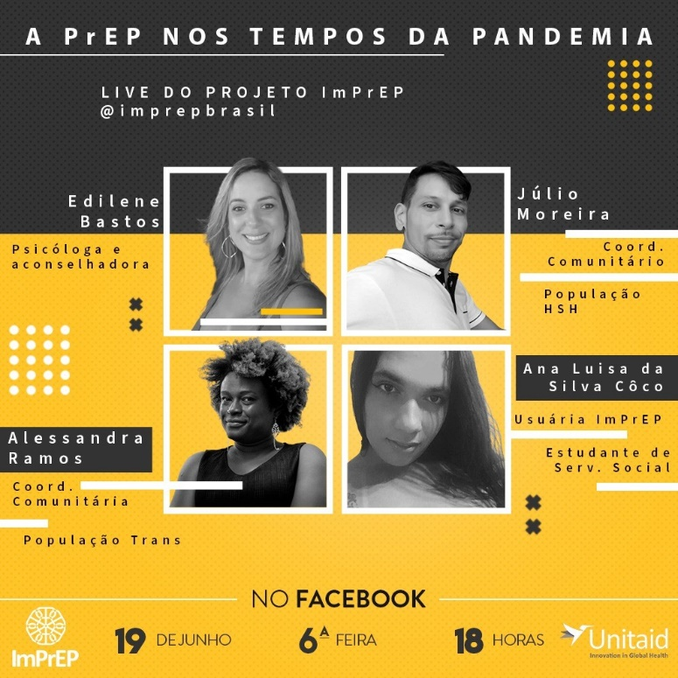

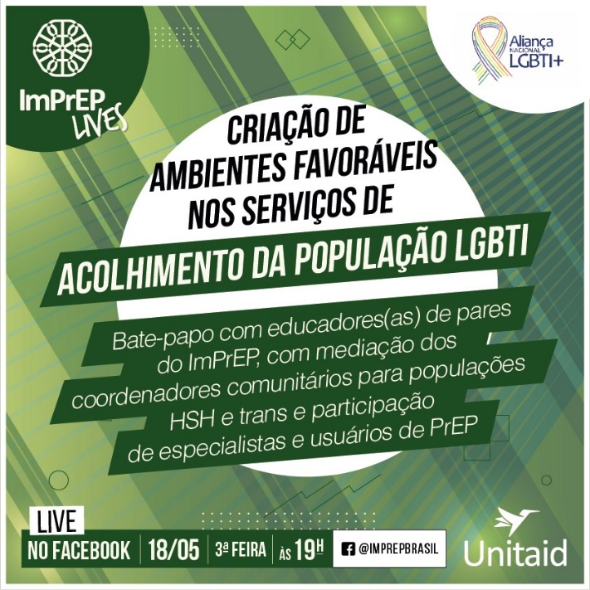
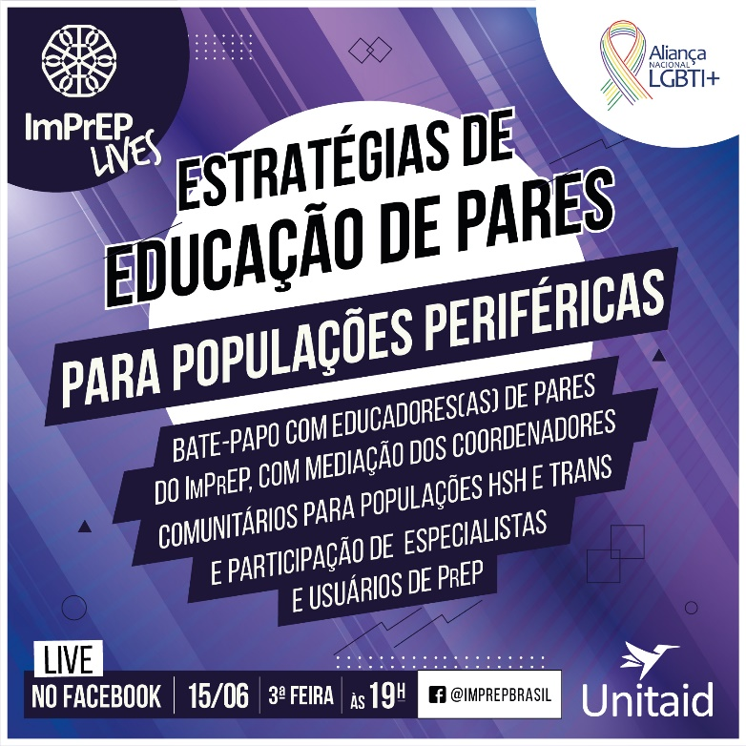
Community Engagement
Community Advisory Board
MSM and TGW peer educators in each site and Community Mobilizers
In-person, client-centered counseling and support and online activities on Facebook and Instagram.
26 live debates and events since March 2020

Slide 11
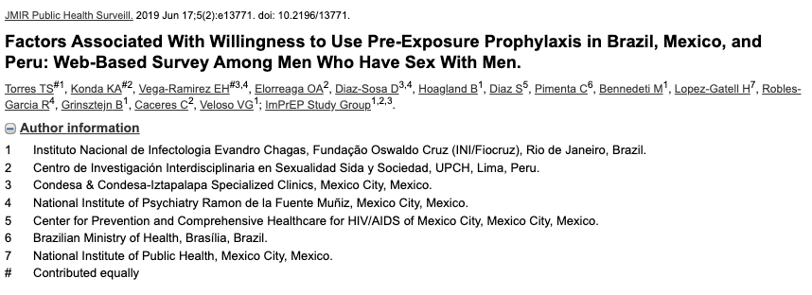
Web-Survey among MSM (2018)
Accessed the survey
(Brasil, México e Peru):
43,687
Completed
19,487 (47%)
Brazil
11,367
58%
Mexico
5,934
31%
Peru
2,156
11%

Slide 12
Awareness of PrEP (2018)
Mexico
64%
Brazil
69%
Factors associated with PrEP awareness:
Higher HIV risk
Higher schooling
Higher income
Substance use previous 6 months
Peru
47%
Assaf, et al. Association of higher risk and PrEP awareness among MSM in Brazil, Mexico and Peru. CROI Conference. Seattle, 2019. Abstract 975.

Slide 13
Willingness to use daily oral PrEP (2018)
13
Mexico
70%
10
8
12
Factors Associated with Willingness to use daily oral PrEP
PrEP awareness
PrEP facilitators
PrEP behavioral barriers (e.g. concerned by daily regimen) PrEP belief barriers (e.g. sexual partners may expect condomless sex)
9
11
14
Brazil62%
Brazil:
1- Rio de Janeiro: 66.8% (n=1589)
2- São Paulo: 63.2% (n=3198)
3- Southeast: 63.0% (n=1376)
4- North: 63.5% (n=562)
5- Central-west: 61.3% (n=1085)
6- South: 58.8% (n=1439)
7- Northeast: 58.4% (n=2097)
Mexico:
8- West: 73.4% (n=654)
9- Central-south: 71.5% (n=2618)
10- North-east: 69.5% (n=485)
11- East: 69.4% (n=559)
12- Central-north: 64.6% (n=480)
13- North-west: 69.2% (n=545)
14- South: 66.3% (n=576)
Peru:
15- Lima: 58.7% (n=1576)
16- Coast: 58.3% (n=338)
17- Highlands: 50.9% (n=161)
18- Jungle: 47.8% (n=69)
18
4
17
7
15
Peru
57%
5
16
3
2
1
6
Torres, et al. Factors Associated With Willingness to Use Pre-Exposure Prophylaxis in Brazil, Mexico, and Peru: Web-Based Survey Among Men Who Have Sex With Men. JMIR Public Health Surveill. 2019 Jun 17;5(2):e13771.

Slide 14
Preferences for PrEP Technologies (2018)
Factors associated with preferring injectable PrEP:
no previous HIV testing
higher number of sexual partners
binge drinking
N=19487
42% injectable PrEP
35% daily oral PrEP
23% ED-PrEP
Torres, et al. MSM at high HIV risk in Latin America prefer long-acting PrEP. AIDS Conference. Virtual, 2020. Abstract PEC0715.

Slide 15
Web-survey 2018 Brazil, Mexico and Peru
 | Brazil N=11118 (58.8%) | Mexico N=5724 (30.3%) | Peru N=2074 (11.0%) | Total N=18916 (100%) | P value ª
HIV testing (n=18780)
Never | 1940 (17.6) | 1277 (22.5) | 498 (24.2) | 3715 (19.8)
Last 3 months | 3436 (31.1) | 1368 (24.1) | 529 (25.7) | 5333 (28.4)
Last 6 months | 1942 (17.6) | 994 (17.6) | 312 (15.2) | 3248 (17.3)
Last 12 motnhs | 1790 (16.2) | 818 (14.4) | 270 (13.1) | 2878 (15.3)
More than 12 months | 1945 (17.6) | 1211 (21.4) | 450 (21.9) | 3606 (19.2) | <0.001
Reasons for not testing (n=3469)
No risk | 411 (21.2) | 295 (24.3) | 103 (21.1) | 809 (22.2)
Not easy / lazy | 400 (20.6) | 152 (12.5) | 81 (16.6) | 633 (17.4)
Shame | 423 (21.7) | 233 (19.2) | 119 (24.3) | 775 (21.3)
Afraid | 448 (23.1) | 431 (35.5) | 158 (32.3) | 1037 (28.4)
Other | 261 (13.4) | 104 (8.6) | 28 (5.7) | 393 (10.8) | <0.001
HIVST awareness (yes; n=18678) | 4488 (41.0) | 1582 (27.9) | 508 (24.8) | 6578 (35.2) | <0.001
HIVST willingness (n=18916) | 4864 (43.7) | 2080 (36.3) | 665 (32.1) | 7609 (40.2) | <0.001
BARRIERS TO HIVST
afraid to use | 2819(25.4) | 1914 (33.4) | 781 (37.7) | 5514 (29.1) | <0.001
Shame | 3942(35.5) | 1129(19.7) | 743(35.8) | 5814(30.7) | <0.001
know how to deal + result | 4814(43.3) | 2588(45.2) | 856(41.3) | 8258(43.7) | <0.001
people have difficult to deal with + | 9388(84.4) | 4105(71.7) | 1607(77.5) | 15100(79.8) | <0.001
I dont trust HIVST | 4392(39.5) | 2005(35.0) | 838(40.4) | 7235(38.2) | <0.001
pre-conseling essential | 7824(70.4) | 4355(76.1) | 1638(79.0) | 13817(73.0) | <0.001
pos-conseling essential | 9628(86.8) | 4963(86.7) | 1827(88.1) | 16418(86.8) | 0.18

Slide 16
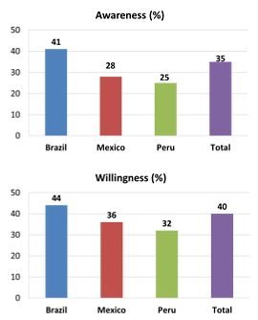
Web-survey 2018 Brazil, Mexico and Peru
HIV Self-Testing (2018)
Factors associated with willingness to use HIVST:
higher income
higher schooling
willingness to use PrEP
Torres, et al. Willingness to use HIV self-testing among MSM in Brazil, Mexico and Peru. CROI Conference. Seattle, 2019. Abstract 936.

Slide 17
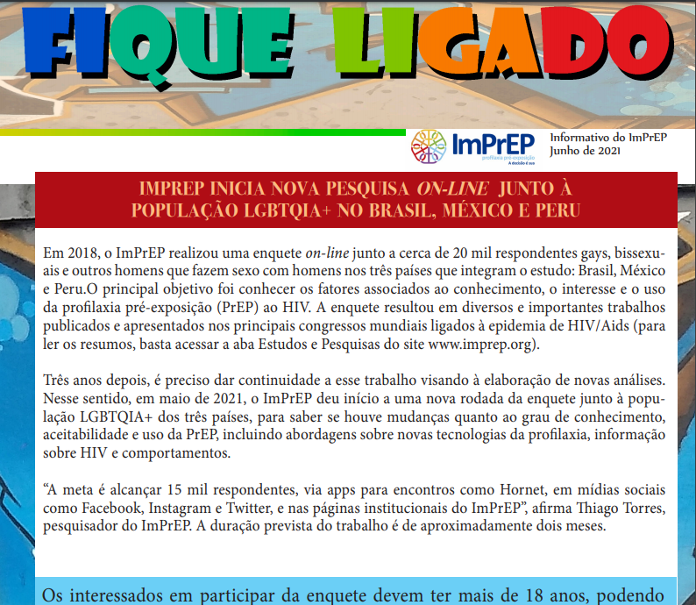
Web-Survey 2021
Willingness to use daily oral PrEP
Knowledge and preferences for other PrEP Technologies
Started: May 2021

Slide 18
The ImPrEP Demonstration Study
Multi-site prospective, open-label demonstration study to assess uptake, acceptability and feasibility of same day, daily oral PrEP with TDF/FTC among MSM and TGW in Brazil, Mexico and Peru.

Slide 19
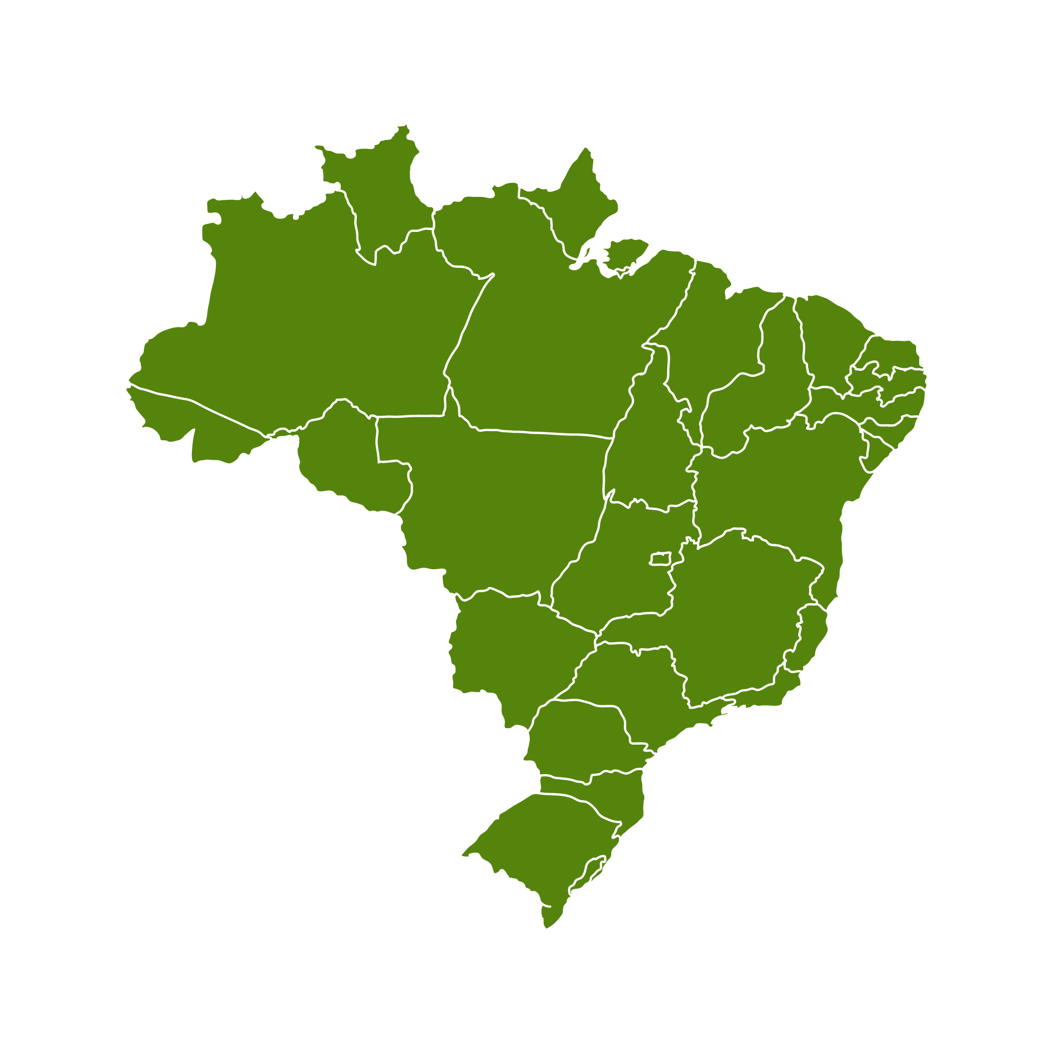
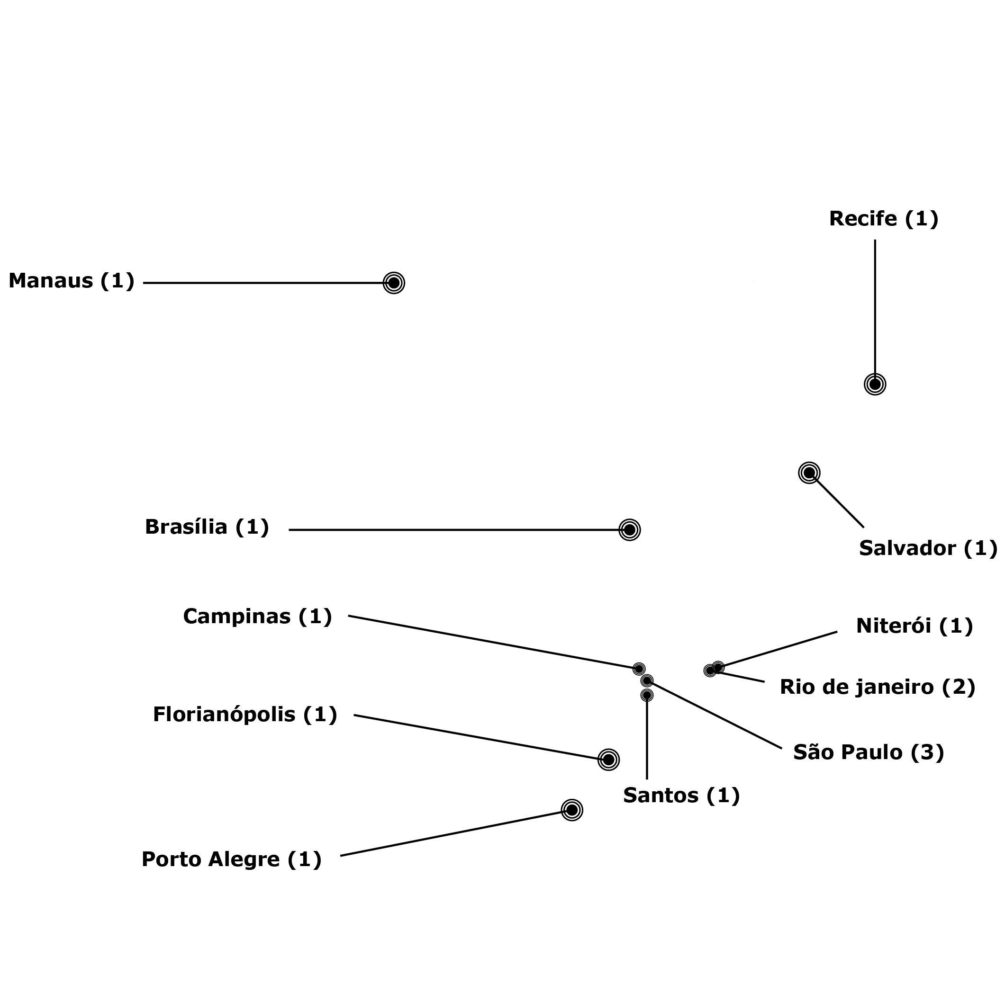

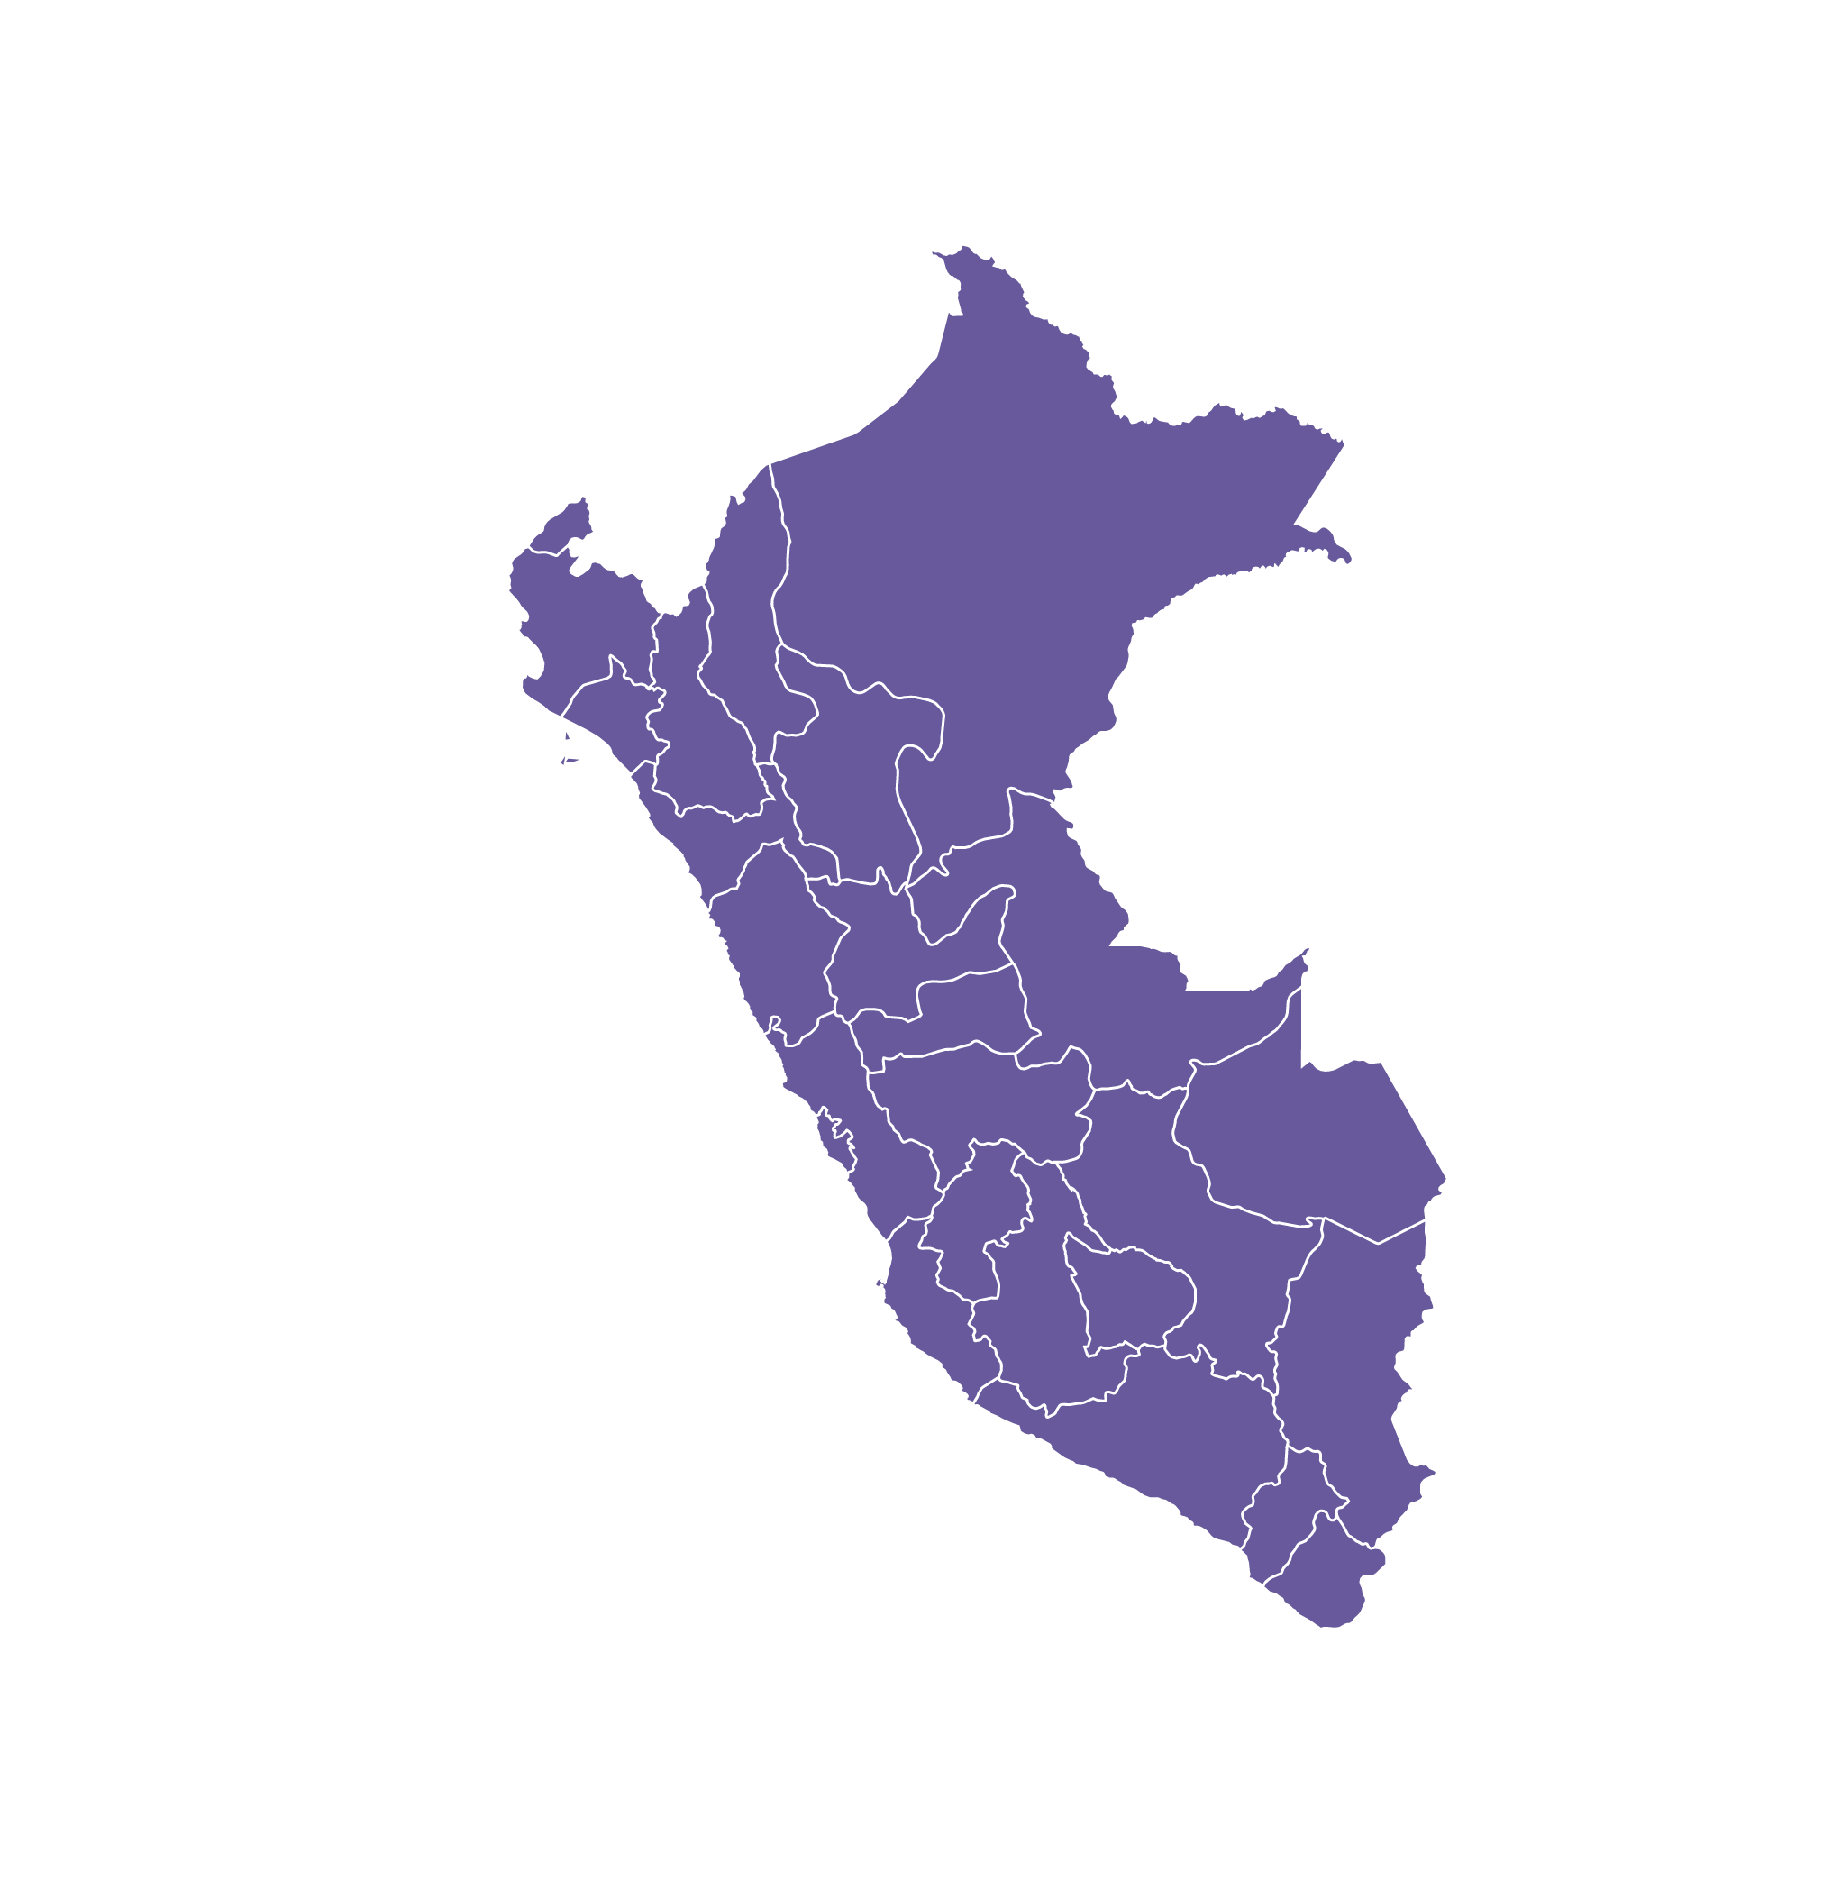

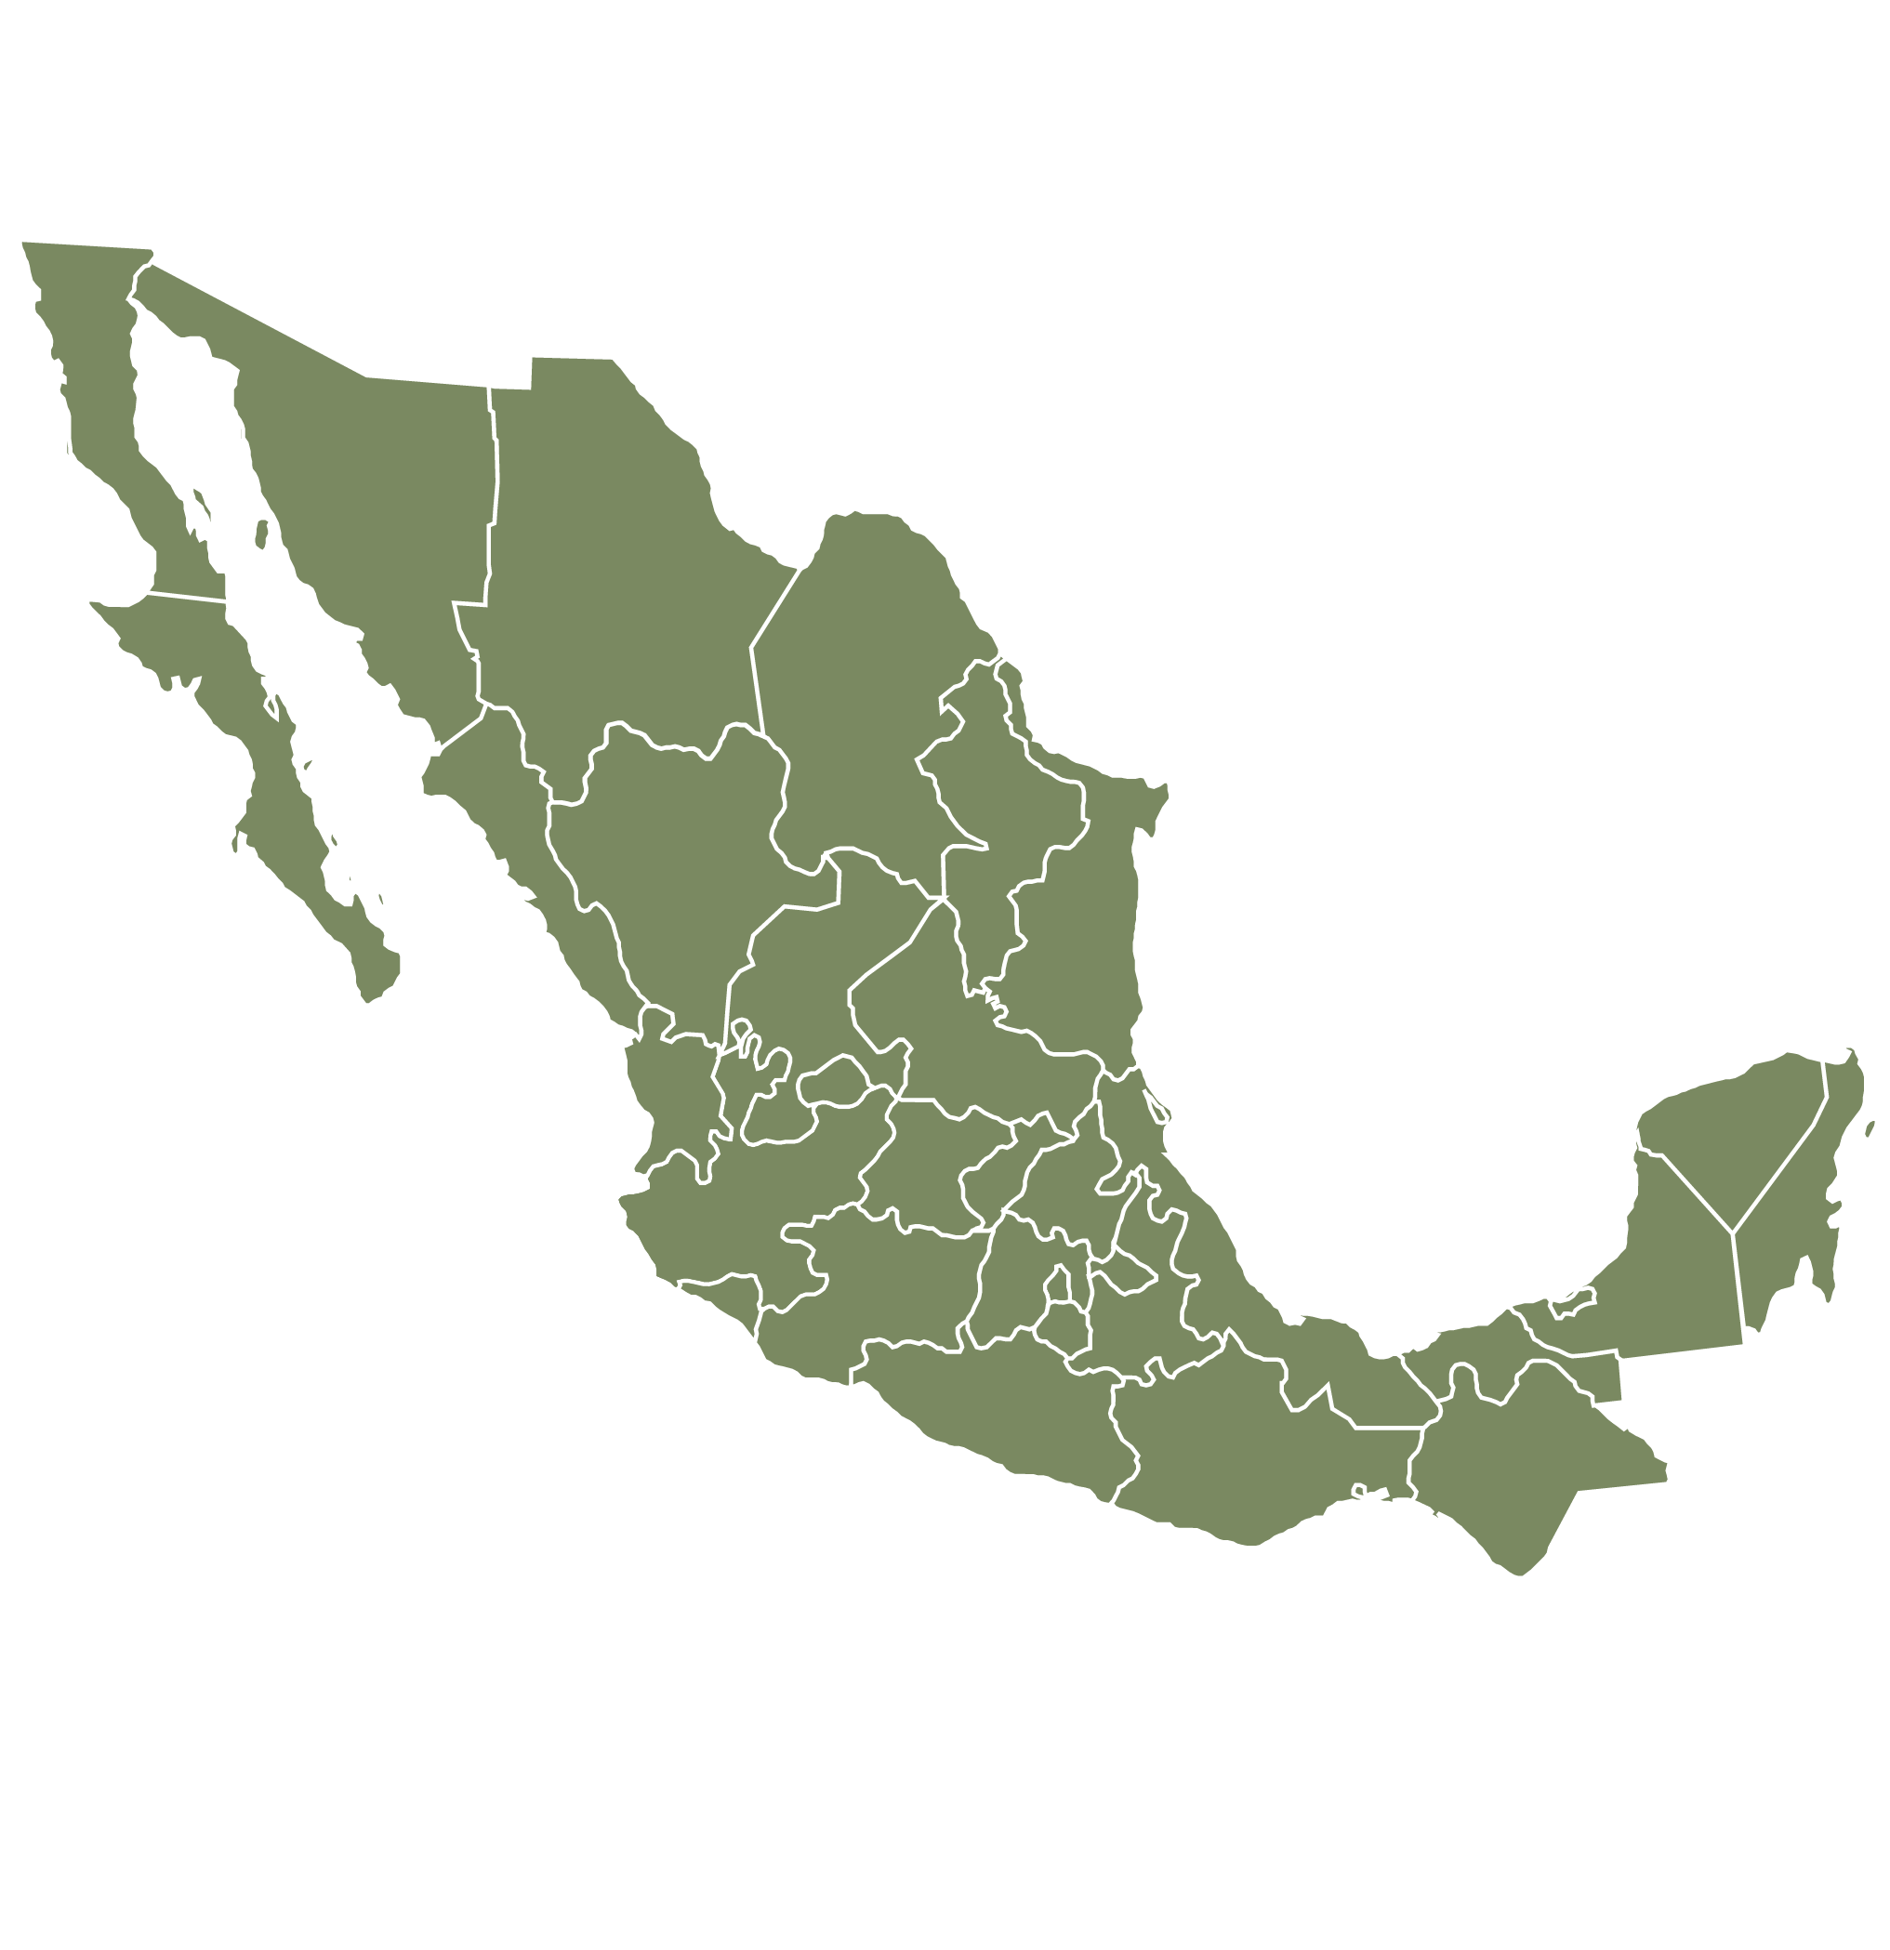
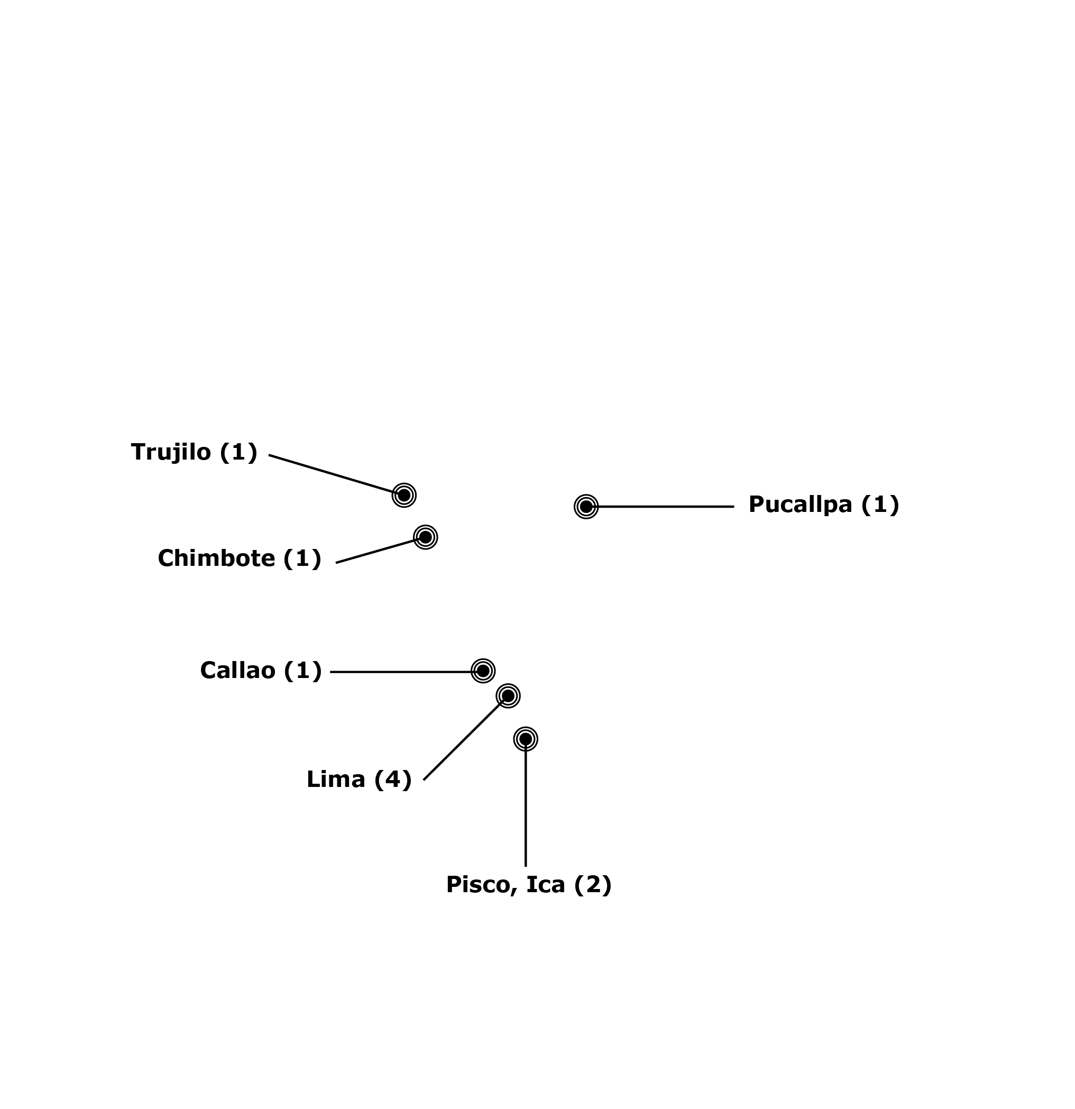

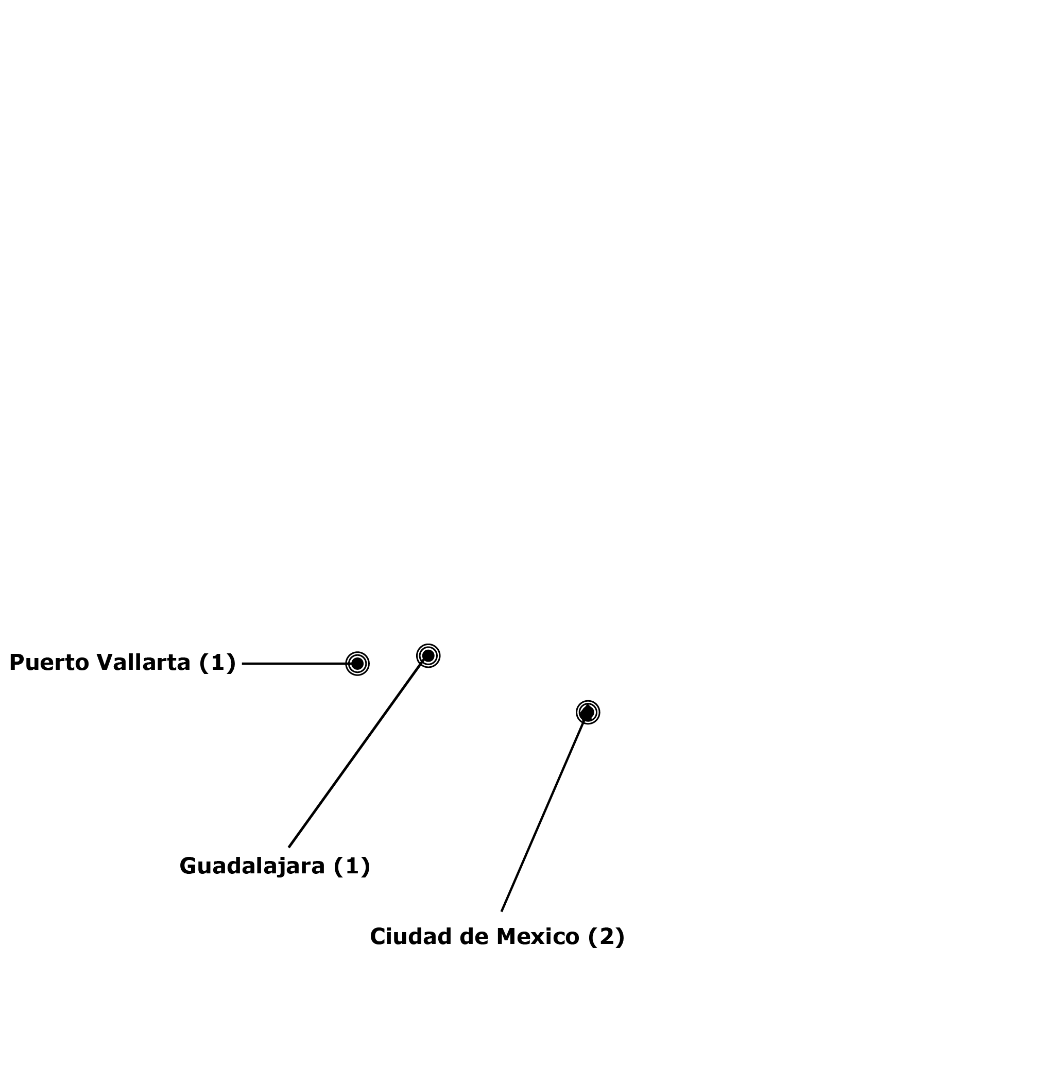
Brazil
14 sites in 11 cities
Mexico
4 sites in 3 cities
Peru
10 sites in 6 cities
Notes:
Eligible participants were HIV uninfected MSM and TGW ≥18 years old at high risk for HIV infection . Participants were screened and enrolled on the same day at 15 sites in Brasil 8 sites in Mexico and 10 sites in Peru and received a 30 days’ supply of TDF/FTC.

Slide 20
ImPrEP Demonstration Study
Sociodemographic Characteristics
 | Brazil | Mexico | Peru | Overall
Age
18 - 24 | 1083 (26.00%) | 655 (19.49%) | 948 (32.86%) | 2686 (25.80%)
25 - 34 | 1939 (46.55%) | 1819 (54.14%) | 1246 (43.19%) | 5004 (48.07%)
35+ | 1143 (27.44%) | 886 (26.37%) | 691 (23.95%) | 2720 (26.13%)
median (IQR) | 29 (24-35) | 30 (25-35) | 27 (23-34) | 29 (24-35)
Educational level
less than secondary/secondary | 890 (21.37%) | 728 (21.67%) | 945 (32.76%) | 2563 (24.62%)
more than secondary | 3275 (78.63%) | 2632 (78.33%) | 1940 (67.24%) | 7847 (75.38%)
Race
white | 1958 (47.01%) | 465 (13.84%) | 293 (10.16%) | 2716 (26.09%)
non white | 2297 (52.99%) | 2895 (86.16%) | 2592 (89.84%) | 7694 (73.91%)
Total enrolled | 4165 | 3360 | 2885 | 10410

Slide 21
ImPrEP Demonstration Study
Sociodemographic Characteristics
 | Brazil | Mexico | Peru | Overall
Gender
MSM | 3944 (94.69%) | 3263 (97.11%) | 2556 (88.60%) | 9763 (93.78%)
TGW | 221 (5.31%) | 97 (2.89%) | 329 (11.40%) | 647 (6.22%)
Total enrolled | 4165 | 3360 | 2885 | 10410

Slide 22
Behavioural Characteristics
 | Brazil | Mexico | Peru | Overall
Number of sex partners in last 3 months
median (IQR) | 5 (2-15) | 8 (4-15) | 4 (2-10) | 5 (2-15)
Condomless anal sex
yes | 3718 (89.27%) | 3199 (95.21%) | 2746 (95.18%) | 9663 (92.82%)
no | 447 (10.73%) | 161 (4.79%) | 139 (4.82%) | 747 (7.18%)
Sex workers
yes | 432 (10.37%) | 748 (22.26%) | 637 (22.08%) | 1817 (17.45%)
no | 3733 (89.63) | 2612 (77.74%) | 2248 (77.92%) | 8593 (82.55%)
Total enrolled | 4165 | 3360 | 2885 | 10410

Slide 23
ImPrEP Demonstration Study
Sexually Transmitted Infections
 | Overall TGW | Overall 18-24
Syphilis | 15.78% (95%CI: 12.87– 18.69) | 8.89% (95%CI: 7.78– 10.00)
Ghonorrhea | 12.89% (95%CI: 10.07– 15.71) | 11.45% (95%CI: 10.14– 12.76)
Chlamydia | 16.57% (95%CI: 13.45– 19.70) | 14.20% (95%CI: 12.76– 15.64)

Slide 24
PrEP early continuation, long term engagement and adherence as measured by the medication possession ratio in the first year of follow-up
 | Early continuation | Long term engagement | MPR >= 0.53
Brazil | 92.45% | 78.10% | 85.22%
Mexico | 87.79% | 68.55% | 77.41%
Peru | 69.39% | 42.96% | 56.96%
Overall | 85.40% | 66.90% | 76.13%
Overall TGW | 67.25% | 44.11% | 53.63%
Overall 18-24 | 79.15% | 56.90% | 67.78%

Slide 25
HIV incidence rate
 | Person years (PY) | HIV Incidence per 100 person years (CI 95%)
Brazil | 6033.39 | 0.3 (0.1-0.5)
Mexico | 2951.30 | 0.4 (0.3-0.8)
Peru | 2145.46 | 2.4 (1.8-3.2)
Overall | 11130.15 | 0.8 (0.6-0.9)

Slide 26
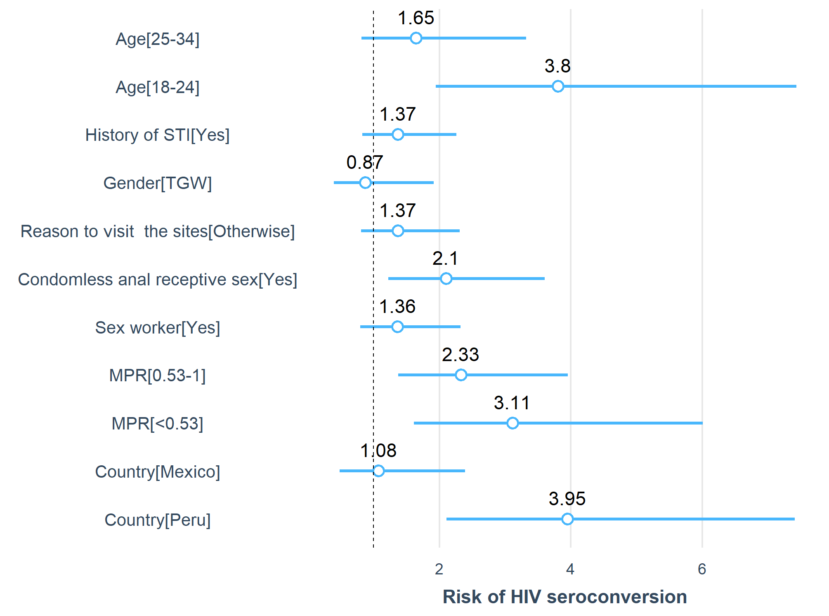
Factors Associated with HIV Seroconversion
FACTOR | aHR, 95% CI
Aged 18-24 | 3.8, 2.0- 7.4
CRAS | 2.1, 1.2-3.6
MPR 0.53-1 | 2.3, 1.4-4.0
MPR<0.53 | 3.1, 1.6-6.0
From Peru | 3.95, 2.1-7.4

Slide 27
Lessons Learned
ImPrEP was successful in enroll MSM & TGW in high risk of HIV infection
Same day oral PrEP with TDF/FTC is feasible among MSM and TGW in Latin America
Those harder to reach are also at higher risk of PrEP discontinuation, increasing inequalities on PrEP benefits
Young MSM and TGW should be targeted with interventions to support them on PrEP engagement
Strategies to support young PreP users and TGW must be developed and implemented starting at PrEP Program entry
Community Education can play a role in increasing PrEP awareness in the community, reaching out to the most vulnerable

Slide 28
Impact of COVID-19 in Brazil
Web-Survey April-May 2020
PrEP users (N=733): 28% stopped PrEP
Non-PrEP users: 87% aware of PrEP and 23% had PrEP eligibility
Black and low-income SGM had more difficulties in maintaing social distancing.
N=3486
sexual and gender minorities (SGM)
45% on sexual abstinence
65% decresed the number of casual sexual partners
Torres TS, et al. Impact of COVID-19 Pandemic on Sexual Minority Populations in Brazil: An Analysis of Social/Racial Disparities in Maintaining Social Distancing and a Description of Sexual Behavior. AIDS Behav. 2021 Jan;25(1):73-84.

Slide 29
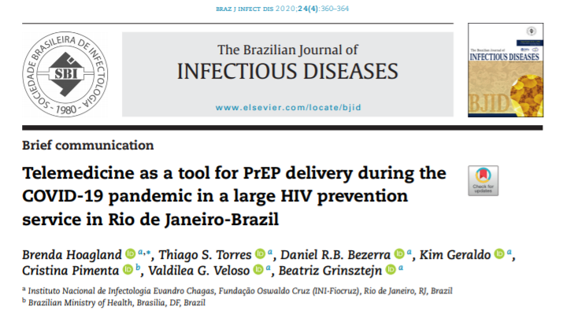
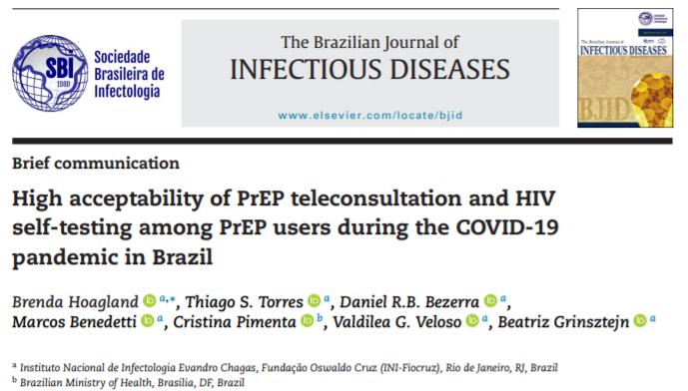

Slide 30
Impact of COVID-19 in ImPrEP users
IAS 2021: Abstract A-IAS2021-00357
N=3211 PrEP users in Brazil (53%), Peru (28%) and Mexico (19%)
The impact of the COVID-19 crisis was differential by country, considering personal life, mental health, sexual behavior and PrEP use.
Peruvian participants reported higher impact on personal life, including economics, access to food, and challenges in accessing health care.
Brazilians had higher reports of mental health issues, including increased substance use.
More Mexicans reported decreasing in sex, although their number of casual partners and condomless receptive anal sex remained higher than Brazil and Peru.
1070 (33.3%) stopped PrEP in that period: 15% in Brazil; 61% in Peru and 33% in Mexico

Slide 31
Qualitative Evaluation of PrEP Implementation in Brazil – “ImPrEP Stakeholders”
Objective:
To assess perceptions and concerns of key partners and stakeholders associated to PrEP policy and program implementation in public health services. In depth interviews were conducted with program managers, health providers, PrEP users (MSM and TGW), and civil society leadership in selected sites in Brazil.
Results:
71 Interviews were conducted in 6 capital cities implementing ImPrEP - Brasilia, Rio de Janeiro, São Paulo, Porto Alegre, Manaus, Recife and 3 additional cities in Rio de Janeiro and São Paulo states.

Slide 32
Qualitative Evaluation of PrEP Implementation in Brazil – “ImPrEP Stakeholders”
Study main findings
Health service inadequacies were related to opening hours, service location, and structural barriers. Poverty, racism, stigma and discrimination against gender and sexual identities, and criminalization of sex work were described to hamper access to health services for MSM and TGW.
Concerning experience with PrEP use, interviewees stated its importance for HIV prevention, and reported that PrEP was easily incorporated into their sexual health routine, strengthening proper care of other STIs.
Prevention information through IEC materials, targeted Apps, community mobilization and peer educators were identified as essential facilitators for effective access, and linkage to HIV testing and PrEP services. Stigma-free attitudes of health professionals and friendly PrEP services were pointed-out as key to enabling environments and effective PrEP implementation.

Slide 33
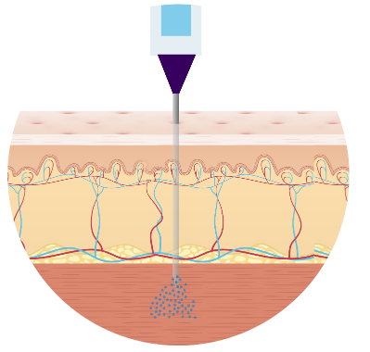
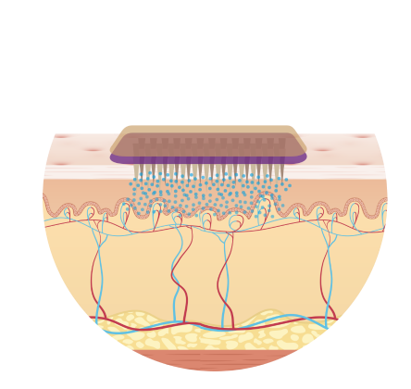




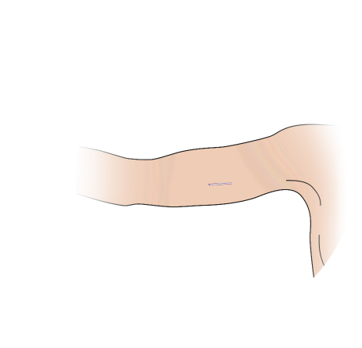



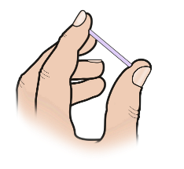



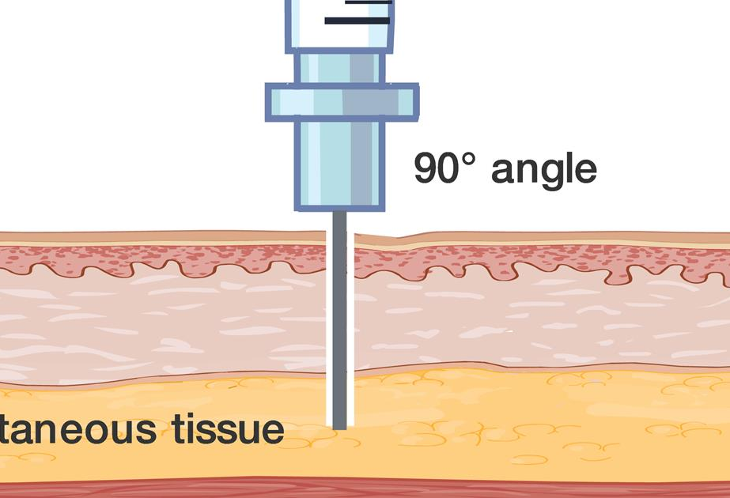
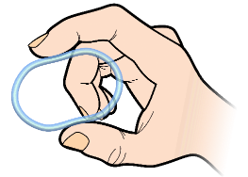
New Technologies
LA intramuscular injection
Microneedle drug patch
Monthly pills
Long-acting ART
Subdermal implant
Vaginal ring
LA subcutaneous injection
Adapted from Scarsi K, International Workshop on HIV & Women 2019.

Slide 34
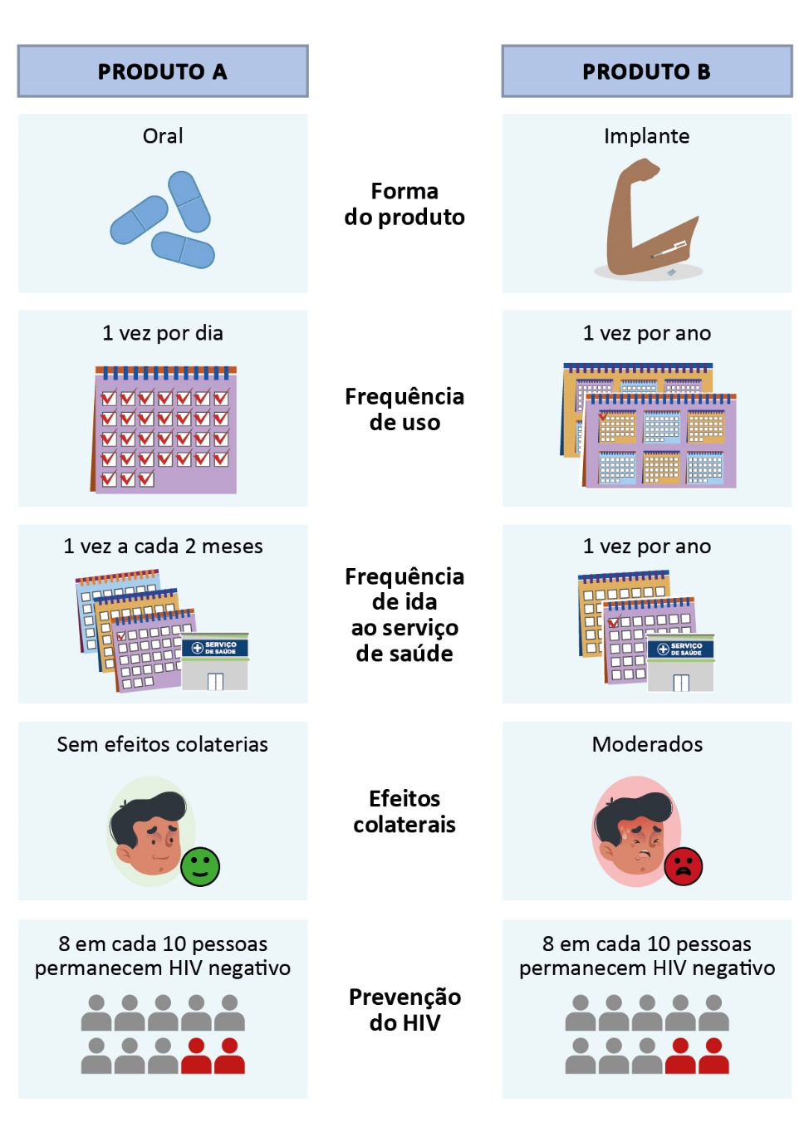
Discrete Choice Experiment (DCE) Brazil
Recruitment:
5 sites: Brasilia, Manaus, Porto Alegre, Rio de Janeiro and Salvador
Online: targeting all Brazil
Questionnaire:
15 questions of product choices
Pereira, et al. Preferences for pre-exposure prophylaxis (PrEP) among men who have sex with men and transgender women at risk of HIV infection: a multicenter protocol for a discrete choice experiment in Brazil. BMJ Open. 2021 Submitted.

Slide 35
PrEP efficacy: most important atribute for PrEP choice
Long-acting PrEP were prefered over more frequent regimens
Discrete Choice Experiment (DCE) Brazil
N=3924
3553 MSM
280 transgender women
91 non binary
Unpublished data

Slide 36
The Value Chain of injectable cabotegravir
as HIV pre-exposure prophylaxis in the SUS
Value chain analysis study was conducted. The CAB LA value was elaborated and the potential costs of implementation of PrEP in the Brazilian Universal Health System from the MoH perspective was calculated. An Instrument was developed to allow constant updating of these costs. The main limitation of the stud was the lack of information on the price of CAB LA in Brazil.

Slide 37
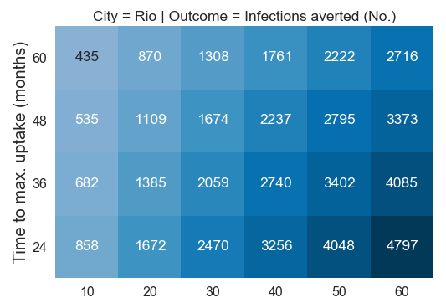
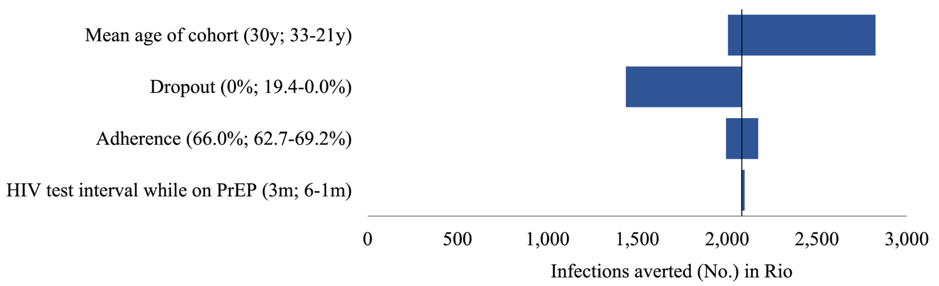
Transmission impact of pre-exposure prophylaxis uptake among gay, bisexual, and other men who have sex with men in urban centers in Brazil
Using CEPAC’s model and local and international PrEP implementation studies were used to inform on critical parameters such as adherence and dropout.
HIV incidence reduction of 32% after 5 years if PrEP uptake of 60% could be achieved within 24 months.
Expanded PrEP in major cities in Brazil could have a substantial impact in reducing HIV incidence over the next 5-10 years.
Focusing on young GBM could greatly increase PrEP’s impact.

Slide 38
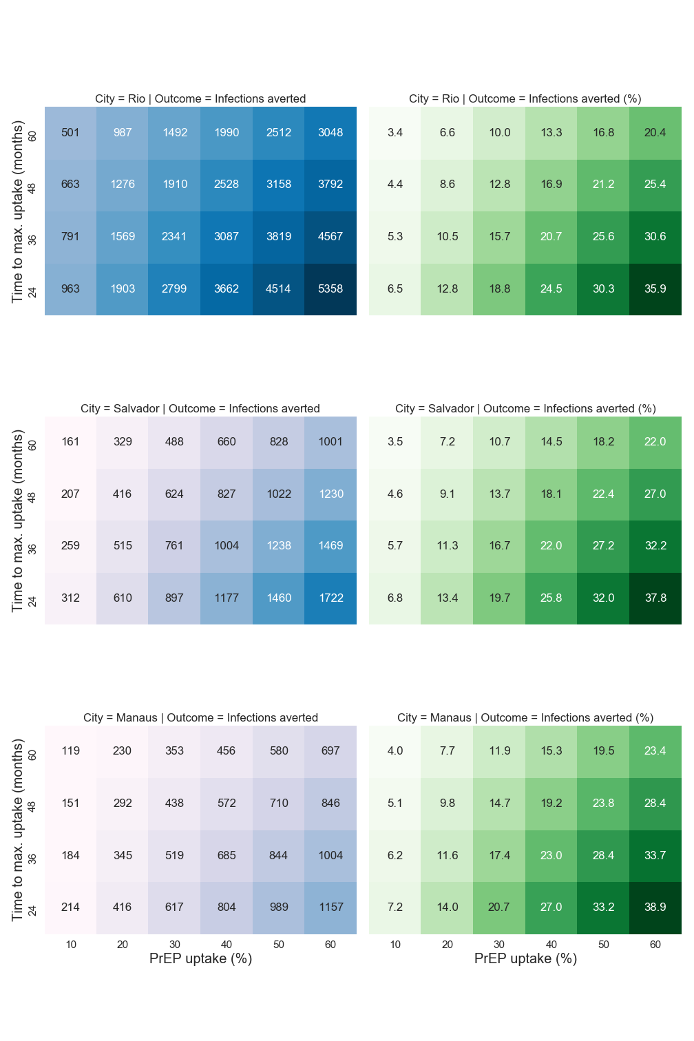
Results
PrEP intervention achieving 10% uptake among MSM within 60 months could avert 501 infections in Rio de Janeiro (Salvador: 133, Manaus: 119) by 5 years.
An intervention achieving 60% uptake among MSM within 24 months would avert ~10-times as many infections (35.9% incidence reduction in Rio de Janeiro, 37.8% in Salvador, and 38.9% in Manaus).

Slide 39
Conclusion
Expanded PrEP in major cities in Brazil could have a substantial impact in reducing HIV incidence over the next 5-10 years. Focusing on young MSM could increase PrEP’s impact.

Slide 40
Ongoing studies
A clinical trial of secondary distribution of HIV self-Test by PrEP users
Seroincidence Study using recency tests & HIV Genotyping

Slide 41
ImPrEP Presentations at IAS 2021
Authors
Title
Modality
Program Number
1
C.F. Caceres, K.A. Konda, R. Moreira, I. Leite, M. Cunha, B. Hoagland, J.V. Guanira, H. Vermandere, H. Vega, B. Grinztejn, C. Pimenta, V. Veloso, ImPrEP Study Group
Early predictors of seroconversion among enrolees in a PrEP program in Brazil, Mexico and Peru – the IMPREP Demonstration study
Oral Presentation
OAC0102
2
Diego Cerecero-García, José Gomez-Castro, Heleen Vermandere, Sergio Bautista-Arredondo
Assessing the cost of PrEP delivery in Mexico: results from the ImPrEP study
e-Poster
PEC304
E.H. Vega-Ramirez, T.S. Torres, C. Guillen-Diaz-Barriga, C. Pimenta, D. Diaz-Sosa, R. Robles-Garcia, K.A. Konda, B. Hoagland, M. Benedetti, S. Diaz, H. Vermandere, S. Bautista-Arredondo, J.V. Guanira, R.I. Moreira, B. Grinsztejn, C. Caceres, V.G. Veloso, MD, PhD, ImPrEP Study Group
Awareness, beliefs, and barriers to prescribing PrEP among physicians in Brazil and Mexico – ImPrEP Study
3
e-Poster
PEC372
4
T.S. Torres, B. Hoagland, K.A. Konda, E.H. Vega-Ramirez, J.V. Guanira, H. Vermandere, R.I.Moreira, I..C. Leite, C. Pimenta, M. Benedetti, S. Bautista, B. Grinsztejn, C. Caceres, V.G.Veloso, ImPrEP Study Group
Impact of COVID-19 pandemic and pandemic response on cisgender men who have sex withmen (MSM) and transwomen in a PrEP cohort from Brazil, Peru and Mexico - ImPrEP study
e-Poster
PEC331
5
B. Hoagland, T. Torres, K.A. Konda, E.H. Vega_Ramirez, J.V. Guanira, H. Vermandere, R.I. Moreira, I.C. Leite, M. Derrico, C. Pimenta, M. Benedetti, S. Bautista, B. Grinsztejn, C. Caceres, V.G. Veloso, ImPrEP Study Group
Awareness of ED-PrEP and interest in switching from daily oral PrEP to ED-PrEP in Brazil, Peru and Mexico – the ImPrEP study
e-Poster
PEC301
6
E. Jalil, T. Torres, C. Pereira; A. Farias; J. Brito; M. Lacerda, D. Silva, T. Andrade, L. Lannoy, M. Valões, N. Wallys, J. Gomes. T. Odara; L. Santiago; S. Nouveau; L. Monteiro; M. Benedetti; C. Pimenta; B. Hoagland; B. Grinzsten; V. Veloso
High rates of sexualized drug use among Brazilian transwomen
e-Poster
PEC378
Annick Borquez, Kelika A. Konda, Oliver A. Elorreaga, Ximena Gutierrez, Juan V. Guanira, Sonia Flores, Gino M. Calvo, Carlos F. Cáceres
Importance of accounting for ART costs saved in the long term when estimating HIV pre-exposure prophylaxis (PrEP) cost-effectiveness: a modeling study informed by the ImPrEP demonstration project.
7
e-Poster
PEC305
8
J.P. Girón, K. Konda, C. Sandoval, G. Calvo, C. Caceres and the ImPrEP Study Group
Understanding barriers and challenges to PrEP adherence: experiences of PrEP discontinuation among MSM and transwomen in Peru - The ImPrEP Demonstration Study
e-Poster
PED652

Slide 42
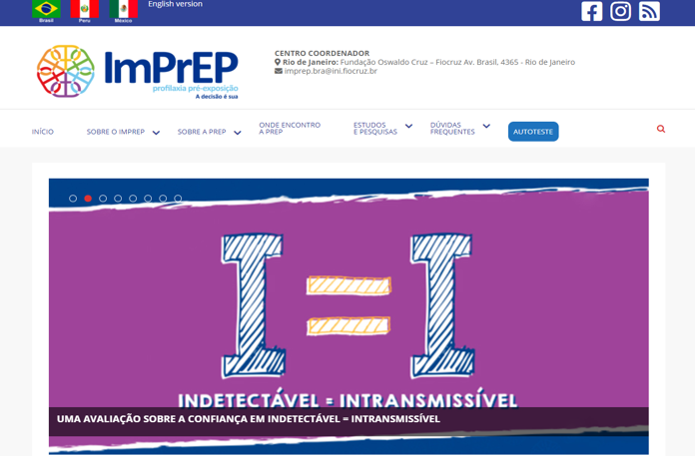
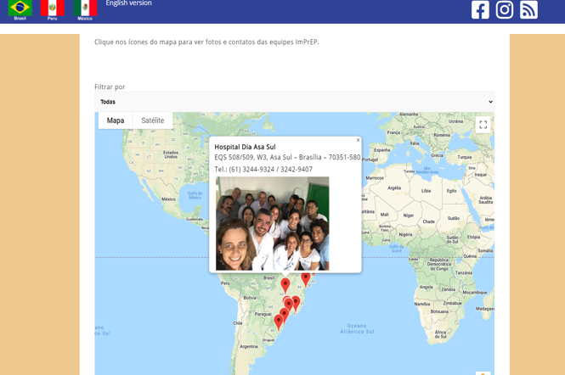
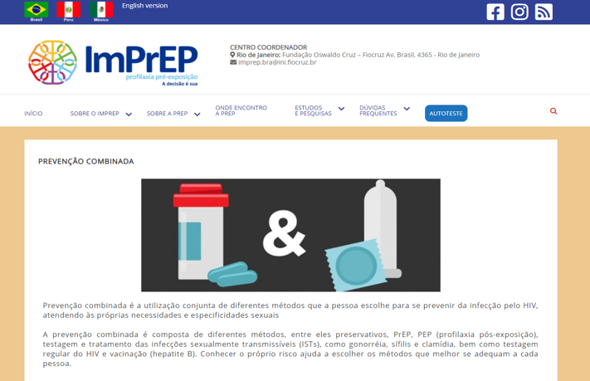
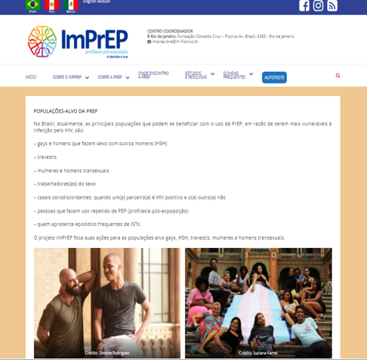
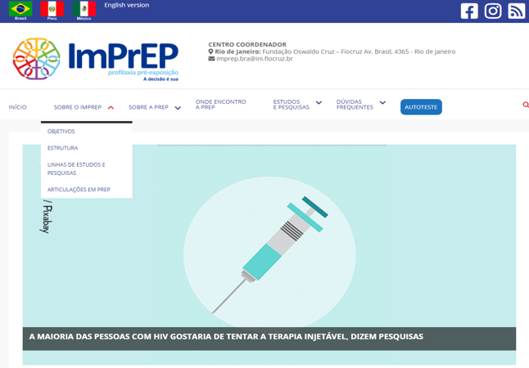
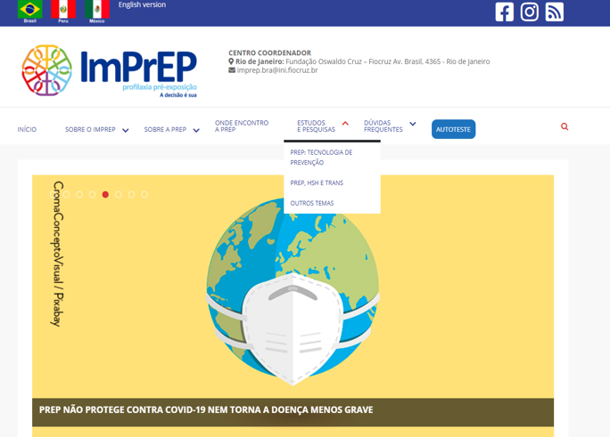
Project Website to disseminate evidence to a broader audience

Slide 43
ImPrEP Study Group
ImPrEP Brazil
ImPrEP Peru
Valdiléa G. Veloso (PI)
Beatriz Grinsztejn (PI)
Brenda Hoagland
M. Cristina Pimenta
Thiago S. Torres
Sandro Nazer
Pedro Leite
Ronaldo I. Moreira
Iuri Leite
Geraldo Marcelo da Cunha
Monica Derrico
Marcio Lessa
Carla Rocha
Lucilene Freitas
Paula Luz
Tania Krstic
Marília Santini
Renato Girade Correa (in memorian)
Renato Lima
Antônio R. de Carvalho
Cláudia Pereira
Alessandra Ramos
Júlio Moreira
Jacinto Corrêa
Daniel Bezerra
Marcos R. Benedetti
Camillla Portugal
Marcus V. de Lacerda
Alessandro Farias
J. David Urbaez-Brito
Polyana d’Albuquerque
Claudio Palombo
Lilian Lauria
Josué Lima
Paulo de Alencastro
Ronaldo Zonta
Raquel K. Ito
José Valdez Madruga
João L. de Benedetti
Fabio V. Maria
Alcinda M. Godoi
Ivia Maksud
Carlos Cáceres (PI)
Kelika Konda
Gino Calvo
Silver Vargas
Juan Vicente Guanira
Oliver Elorreaga
Ximena Gutierrez
Fernando Olivos
Damaris Caviedes
Daniella Oquendo
Eduardo Juárez
Gaby Mariño
Elizabeth Lugo
Jazmin Qquellon
Francesca Vasquez
Jean Pierre Jiron
Sonia Flores
Karen Campos
ImPrEP México
Hamid Vega-Ramírez (PI)
Sérgio Bautista (PI)
Heleen M. Vermandere
Steven Díaz
Dulce Díaz
Centli Guillén
Lorena Hernández
Rebeca Robles
Ma. Elena Medina-Mora
Marcela González
Ivonne Huerta Icelo
Araczy Martinez Davalos
Diego Cerecero Garcia
José Gomez Castro
Santiago Aguilera Mijares
Luis Obed Ocampo Valdez
Alma Cruz
Arantxa Colchero Aragones
ImPrEP Program Officers
Heather L. Ingold
Anna Hellstrom

Slide 44
ImPrEP External Advisory Board
ImPrEP Community Advisory Board - Brazil
Alejandra Trossero (UNAIDS)
Asa Radix (Callen-Lorde Community Health Center)
Carlos Benítes (National HIV and AIDS Program – Peru)
Gerson Pereira (DCCI/Ministry of Health – Brazil)
Giovanni Ravasi (PAHO)
Jean-Michel Molina (University of Paris Diderot)
Patrícia Uribe (CENSIDA – Mexico)
Rachel Baggaley (WHO)
Rosalind Coleman (UNAIDS)
Simón Perez (Somosgay)
Virginie Supervie (French Institute of Health and Medical Research)
Célio Golin (Grupo Nuances)
Kelly Vieira Meira (Associação Estrela Guia)
Ludymilla Santiago Dias (ANAVTRANS – DF)
Paulo Oliveira (Fórum de ONGs/AM)
Ricardo Malacarne (Fórum de ONGs/SC)
Wladimir Reis (GTP+)

Slide 45
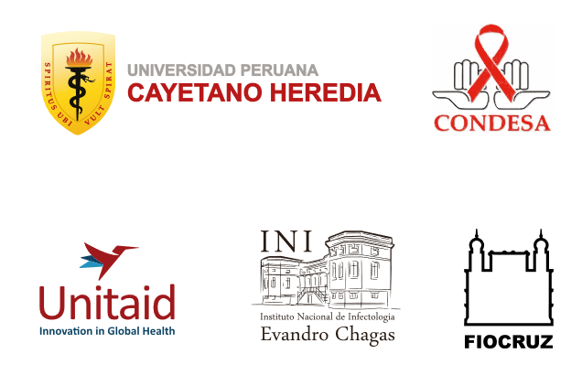
Acknowledgments
Study participants
UNITAID Team, especially our Programa ms Officers
      - Heather L. Ingold
      - Anna Hellstrom
PAHO and WHO technical Teams

Slide 46
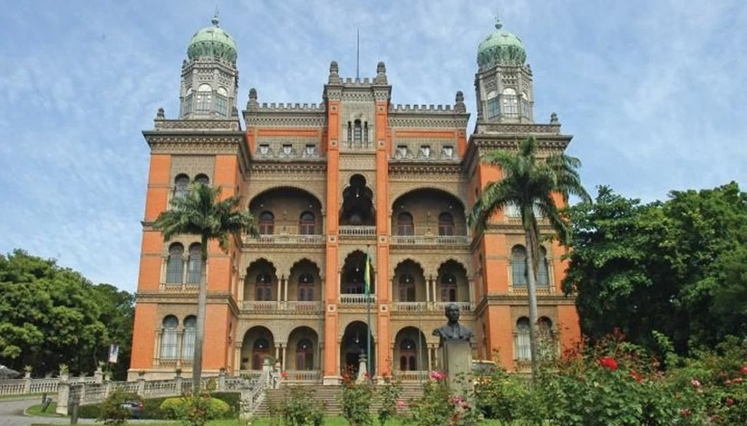
Thank you!
valdilea.veloso@ini.fiocruz.br

